Slide 1

COROWA CONFERENCE
Teacher Tip
Use slideshow mode.
Notes:
On the 31st July and the 1st August, in 1893, a conference was held to promote Federation. It was held in Corowa, in New South Wales, and became known as ‘The Corowa Conference’. It was a key event leading to Federation.

Slide 2
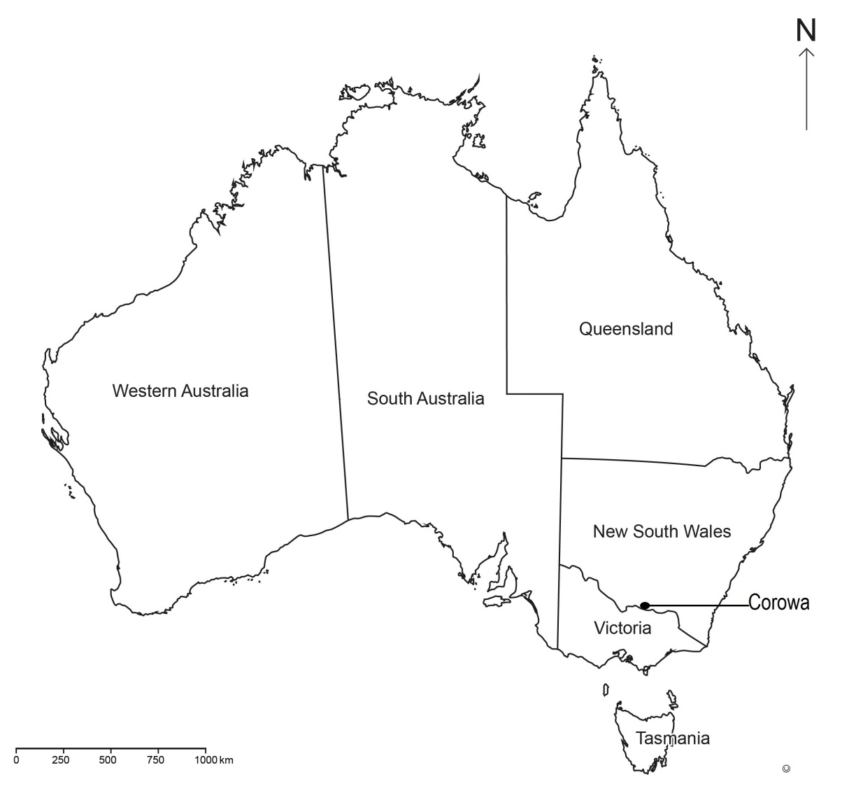
Why Corowa?
There had been other conferences in Sydney and Melbourne promoting Federation, so why was Corowa so important?
Notes:
There had been other conferences in Sydney and Melbourne promoting Federation, so why was Corowa so important? Let’s have a look at where Corowa is located and this might help us to understand its importance. (Click) Corowa is situated in New South Wales but right on the border with Victoria.

Slide 3
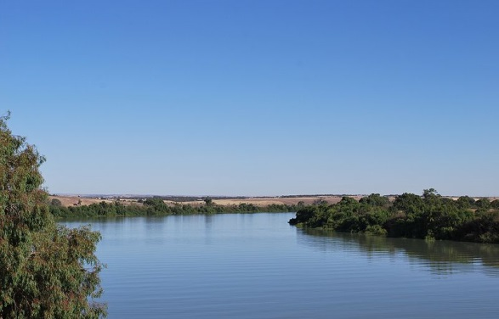
Why Corowa?
The Murray River forms the border between New South Wales and Victoria.
Murray River
Notes:
The Murray River forms the border between New South Wales and Victoria. In the 19th century, the river was actually a formal border crossing. Today, people can move back and forth across the river with no problems, but in the 19th century, it was like crossing into another country. There were formal checks at the border, just as there are today when you go to another country.

Slide 4
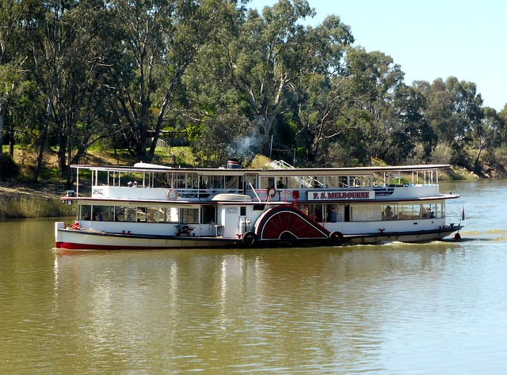
Free trade versus tariffs
The people of Corowa conducted a lot of trade across the border with Victoria.
Paddle steamer on the Murray River
Notes:
The people of Corowa conducted a lot of trade with people on the other side of the Murray River. New South Wales had free trade across their borders, which meant they had no tariffs (tax on goods traded). The Victorian Government, however, protected the goods produced in their colony by charging tariffs on any goods coming into the colony. This made life difficult for people on both sides of the river, so they were very interested in any move that would put an end to the expense and the time-consuming checks at the border.

Slide 5
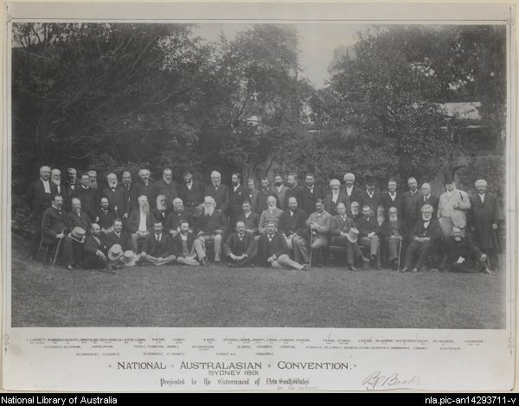
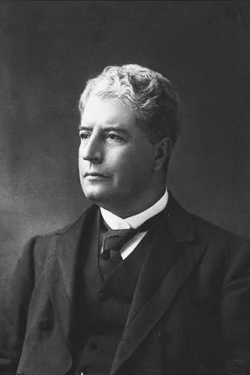
Working towards Federation
‘ a nation for a continent and a continent for a nation’
Edmund Barton, 1891
Participants in the 1891 Federation Convention in Sydney
Notes:
Conferences had been held in Melbourne in 1890 and in Sydney in 1891 to draft a constitution and discuss the issues surrounding Federation. There was general agreement that some kind of union of the colonies would be beneficial for everyone. Edmund Barton, who was later to become Australia’s first Prime Minister, made the famous statement in Sydney (Click) that was to become a slogan for federation, ‘a nation for a continent and a continent for a nation’. However, the draft constitution did not get support from the colonial governments. So what happened? Why did it take another two years to get things moving again?

Slide 6
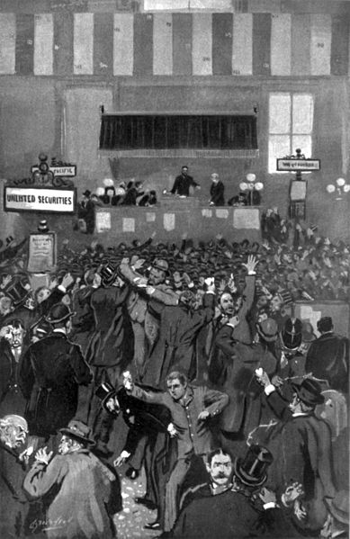
Money problems!
The colonies were experiencing financial stress.
Panic on the New York Stock Exchange
Notes:
Politicians put plans for Federation on hold as the colonies experienced financial problems. There was a major economic depression in 1893 (Click) in New York and the value of company shares plummeted. Over 500 banks went out of business. Some Australian banks also went out of business. People lost their jobs and other businesses collapsed. Colonies had borrowed money to build infrastructure like railways and roads and English banks were demanding the money be repaid.

Slide 7

People power!
Federation was too good an idea to abandon.
Notes:
Ordinary people, however, decided that Federation was not going to fade away. Leagues of interested people along the Murray River were formed and almost every town on both sides of the Murray had representatives in these Federation leagues. They combined into one Australasian Federation League.
It was suggested that a conference of delegates from each of the branches of the Australasian Federation League be held at Corowa to discuss Federation. In July 1893, the Federation leagues held a Federation Conference at Corowa. The meeting was intended to be strictly non-political, so important people who were invited were not to be seen as representatives of political groups. This was not a meeting of people from all over Australia but from New South Wales and Victoria.

Slide 8
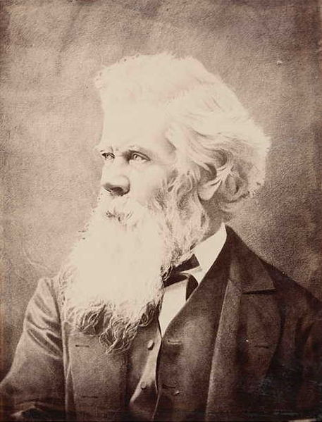
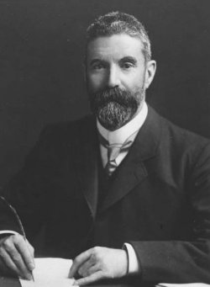
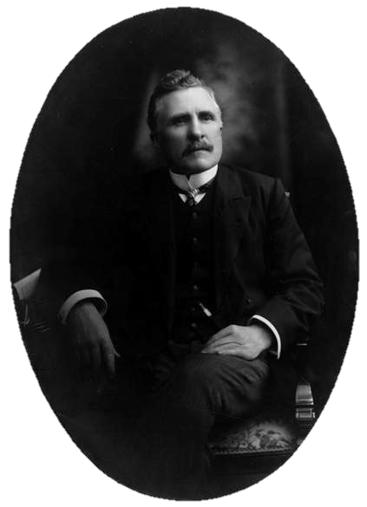
Corowa advances process
Henry Parkes
Edmund Barton
Alfred Deakin
The ‘big three’ weren’t there!
Dr John Quick
Notes:
Consequently, the ‘big three’, the recognised leaders of the Federation movement, (Click) Henry Parkes, (Click) Edmund Barton and (Click) Alfred Deakin, were not there, but (Click) Dr John Quick, a leading supporter of Federation from Victoria, was there. Decisions about moving forward with Federation were received with enthusiastic cheering by those who were there, especially the proposals of Dr Quick. He proved to be very important at this conference.

Slide 9
People not politicians!
A new Federal convention would be made up of delegates elected by the people of each colony.
The Corowa Conference decided on a new approach.
This convention would draw up a new Constitution.
The adoption of the Constitution should be decided by a referendum of the people.
Notes:
To end the resistance of the colonial parliaments, Dr Quick proposed that:
(Click) A new Federal Convention would be made up of delegates elected by the people of each colony.
(Click) This Convention would draw up a new Constitution.
(Click) The adoption of the Constitution should be decided by a referendum of the people.

Slide 10
Success!
1893
Corowa Conference
1895 Conference of Premiers accepts proposals from Corowa
1897–98
Federation conventions prepare Constitution
July 1900
New Constitution given Royal Assent
Referendums agree to Federation
Notes:
(Click) After the Corowa Conference, (Click) the Conference of Premiers in Hobart in 1895 accepted Dr Quick’s suggestions. Special Acts were passed in the colonial parliaments to allow for the election of delegates to the next Federation convention. (Click) These convention meetings were held from 1897 to 1898 and a new Constitution was prepared. (Click) This new Constitution was put to the people in a series of referendums. The people agreed to adopt the proposed Constitution and it was put to the British Parliament (Click), which still had governing power over the Australian colonies, and given royal assent (that is, signed approval by Queen Victoria) in 1900.

Slide 11
Significance of Corowa
Corowa was a very important step on the road to Federation — a ‘turning point’ in the Federation movement.
Notes:
A ‘turning point’ is a significant moment when a course of events begins to change. As you have seen, Corowa was a very important step on the road to Federation. It might even be described as a turning point in the movement towards Federation.

Slide 12
Attributions
Slide 1:
Team Adapted from http://pixabay.com/en/people-group-crowd-team-isolated-309099/
Slide 2:
Map of Australia © DET
Slide 3:
Mattinbgn, Murray River http://commons.wikimedia.org/wiki/File:MurrayBridgeMurrayRiver.JPG CC-BY-SA 3.0 creativecommons.org/licenses/by-sa/3.0/
Slide 4:
Paddle steamer http://pixabay.com/en/paddle-steamer-paddle-boat-riverboat-497309
Slide 5:
National Australasian Convention, Sydney, 1891, National Library of Australia, ID=26932 http://nla.gov.au/nla.obj-136434835/view
Cropped and flipped from Portrait of Edmund Barton National Library of Australia ID nla.obj-136296278 http://nla.gov.au/nla.obj-136296278/view
Slide 6:
Broughton, Charles, The recent panic - scene in the New York Stock Exchange on the morning of Friday, May 5th, 1893, Prints & Photographs Division, Library of Congress, LC-USZ62-66364 (b&w film copy neg.) http://loc.gov/pictures/resource/cph.3b13869/
Slide 7:
Team http://pixabay.com/en/people-group-crowd-team-isolated-309099/
Slide 8:
Sir Henry Parkes, Mitchell Library, State Library of New South Wales – PX*D 624/33
Cropped from Portrait of Edmund Barton National Library of Australia ID nla.obj-136296278 http://nla.gov.au/nla.obj-136296278/view
Cropped from Alfred Deakin, http://commons.wikimedia.org/wiki/File:AlfredDeakin.jpeg
Portrait of Sir John Quick, National Library of Australia, http://www.nla.gov.au/apps/cdview/?pi=nla.pic-an23488021
All other images ©DET

